Slide 1
Applied Data Science Capstone Project
Recreation facilities density in Hong Kong Districts

Slide 2
Introduction
The population of Hong Kong kept increasing in the past decades despite the already high population density.
There are complaints about the lack of public facilities including hospitals, car parks, recreation facilities etc.
In this project, I would like to find out which district in Hong Kong has the least number of recreation facilities normalized by the population of the district.

Slide 3
Data
Recreation facility data (obtained from https://data.gov.hk/en/geospatial-data)
Population data (also obtained from https://data.gov.hk/en/geospatial-data)
Hong Kong district geojson file (obtained from http://opendata.esrichina.hk/datasets/eea8ff2f12b145f7b33c4eef4f045513_0)

Slide 4
Methodology
Get the recreation facility data and get the counting grouped by district
Get the population data stratified by district
Merge these data and calculate the number of facility per 10,000 population in each district
Use folium to plot a choropleth map showing the density of facilities in all districts
Find out the region with the lowest density

Slide 5
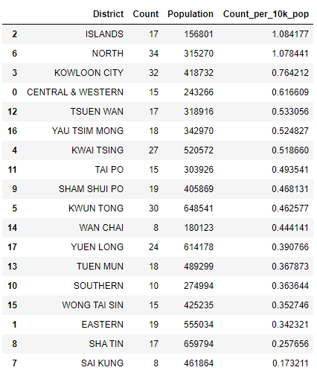
Result
Tidied data frame showing the count of recreation facilities normalized by population number in every district in Hong Kong

Slide 6
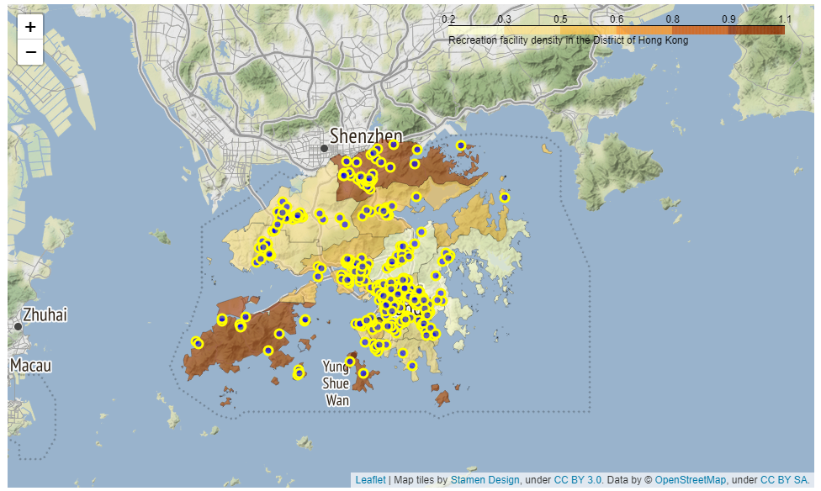
Choropleth map showing the density of facilities in all districts, with the eastern region having the lowest density

Slide 7
Discussion
Finding
  The eastern area of Hong Kong is lacking recreation facilities the most.
Limitations of the finding
  Only public facilities were included while privately owned are not included
    It is more difficult to find the complete list of locations of these facilities
  Some of the facilities are complexes and there are multiple facilities within
    Further studies may need to set weightings among the facilities to give a more complete picture
  Some rural districts are in close proximity to the country parks
    These districts may require less recreation facilities than the other districts
Nevertheless, these findings serve as a starting point for us to look into the distribution of recreation facilities in Hong Kong

Slide 8
Conclusion
We found that the eastern area of Hong Kong (Sha Tin and Sai Kung district) has the least number of recreation facilities normalized by the population, although further studies have to be made to strengthen the finding.

